Slide 1
CSE 477: Introduction to Computer Security
Lecture – 25
Course Teacher: Dr. Md Sadek Ferdous
Assistant Professor, CSE, SUST
E-mail: ripul.bd@gmail.com

Slide 2
Outline
Attacks on Web Protocol
Mitigations Techniques

Slide 3
HTTP Session via Cookie
Another common method of creating user sessions uses small packets of data, called cookies
Cookies are a small bit of information stored on a computer associated with a specific server
This is then are sent to the client by the web server and stored on the client’s machine
When the user revisits the web site, these cookies are returned, unchanged, to the server, which can then “remember” that user and access their session information
Cookies are set on a client’s system when a server uses the Set-Cookie field in the header of an HTTP response

Slide 4
HTTP Session via Cookie
The name and content fields correspond to the key-value pair of the cookie
The domain name .paypal.com specifies that this cookie is valid for this top-level domain and all subdomains
The path / indicates that it applies to the root directory of the site
The send for value indicates that this is not a secure cookie
The expiration date specifies when this cookie will be automatically deleted
If no expiration date is specified, the cookie is deleted when the user exits the browser

Slide 5
Cookie properties
The domain field can be specified for a top-level domain or subdomains of a web site
Only hosts within a domain can set a cookie for that domain
A subdomain can set a cookie for a higher-level domain, but not vice versa
Similarly, subdomains can access cookies set for the top-level domain, but not the other way around
mail.example.com could access cookies set for example.com or mail.example.com
example.com could not access cookies set for mail.example.com
Hosts can access cookies set for their top-level domains, but hosts can only set cookies for domains one level up in the domain hierarchy
one.mail.example.com could read (but not set) a cookie for .example.com

Slide 6
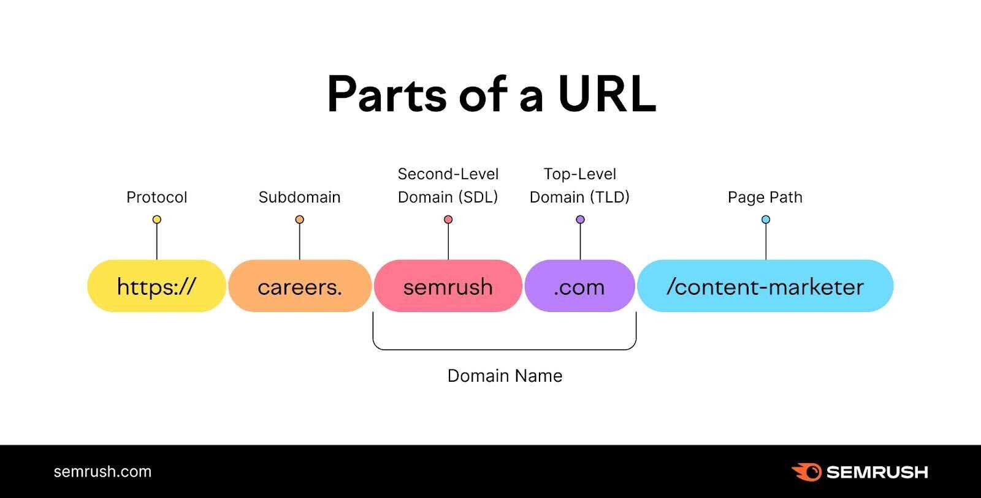

Slide 7
Cookie properties
The path field specifies that the cookie can only be accessed within a specific subdirectory of the web site
defaults to the root directory of a given domain if path is absent
By default, cookies are transmitted unencrypted using HTTP, and as such are subject to the same man-in-the-middle attacks as all HTTP requests
To remedy this weakness, a secure flag, which requires that a given cookie be transmitted using HTTPS, can be set
Situations have been disclosed where web sites using HTTPS to encrypt regular data transfer failed to properly set the secure cookie flag
Resulting in the possibility of session hijacking
A sensitive cookie can be further protected by encrypting its value and by using an opaque name
Thus, only the web server can decrypt the cookie and malware that accesses the cookie cannot extract useful information from it

Slide 8
Cookie properties
Finally, cookies can set an HTTP-Only flag
If enabled, scripting languages are prevented from accessing or manipulating cookies stored on the client’s machine
This does not stop the use of cookies themselves
The browser will still automatically include any cookies stored locally for a given domain in HTTP requests to that domain!
In addition, the user still has the ability to modify cookies through browser plugins

Slide 9
HTTP session via cookie
To let the server access previously set cookies, the client automatically includes any cookies set for a particular domain and path in the Cookie field of any HTTP request header being sent to that server
Notably, a user’s cookies are accessible via the DOM, and therefore can be accessed by many scripting languages
The cookie specification is built directly into the HTTP protocol, which is interpreted by the browser
As a result, the mechanism for setting and accessing cookies is different for each scripting language

Slide 10
HTTP session via cookie
Many languages have their own built-in cookie APIs that provide convenient means of using cookies
But other languages, including JavaScript, treat cookies as simple strings of text stored in the DOM
All of these properties of cookies are managed by the browser, rather than the operating system
Each browser sets aside space for storing this information, and allows the possibility of a user having separate sets of cookie information for each of multiple browser

Slide 11
Cookie security
Cookies have profound implications for the security of user sessions
For instance, it is dangerous to store any sensitive information unencrypted in the body of a cookie, since cookies can typically be accessed by users of the system on which they are stored
Even if sensitive information is encrypted, however, accessing a user’s cookies for a web site may allow an attacker to assume that user’s session
Because of this, there is a need for users to protect their cookies as they would any login information
The expiration date built into cookies is a good preventive measure, but it is still recommended that users erase their cookies on a regular basis to prevent such attacks
In addition to these security concerns, cookies also raise several issues related to user privacy discussed later

Slide 12
Server side session
A final method of maintaining session information is to devote space on the web server for keeping user information
This model reduces several risks for the user, because compromise of the user’s system no longer necessarily results in compromise of their web sessions
Widely used in e-commerce websites for maintaining shopping carts

Slide 13
Server side session
For this, servers typically use a session ID or session token — a unique identifier that corresponds to a user’s session
The server then employs one of the two previous methods (GET/POST variables or cookies) to store this token on the client side
When the client navigates to a new page, it transfers this token back to the server, which can then retrieve that client’s session information
A session ID should be hard to guess by an attacker
Thus, a typical mechanism for issuing session IDs involves the use of a random number generator or of a message authentication code
Note that, if the client’s computer is ever compromised, then all the attacker learns is an old session ID that is likely to have expired by the time the attack occurs

Slide 14
Session hijacking
Similar to TCP session hijacking, HTTP sessions can also be taken over in session hijacking attacks
Such an attack can be especially damaging if strong authentication is used at the beginning of an HTTP session but communication between the client and server is unencrypted after that
Performing an HTTP session hijacking attack not only requires that the attacker intercept communication between a web client and web server
But also requires that the attacker impersonates whatever measures are being used to maintain that HTTP session

Slide 15
Session hijacking
If the attacker is utilising a packet sniffer, then he might be able to discover any session IDs that are being used by a victim
Likewise, he might also be able to mimic session tokens encoded in cookies or GET/POST variables
Given this information, an attacker can hijack an HTTP session
If an attacker can reconstruct a valid server-side session token, or mimic a client-side token, then he can assume the identity of the legitimate user with that token
Thus, a first line of defence against HTTP session hijacking is to protect against packet sniffers and TCP session hijacking

Slide 16
Session hijacking defence
To prevent session hijacking attacks in client-side tokens, it is important for servers to encrypt session tokens
Likewise, server-side session IDs should be created in ways that are difficult to predict, for instance, by using pseudo-random numbers.
In addition, it is also important for servers to defend against possible replay attacks
which are attacks based on reusing old credentials to perform false authentications or authorizations
In this case, a replay attack would involve an attacker using an old, previously valid token to perform an attempted HTTP session hijacking attack
A server can protect against such attacks by incorporating random numbers into client-side tokens, as well as server-side tokens, and also by changing session tokens frequently, so that tokens expire at a reasonable rate
Another precaution is to associate a session token with the IP addresses of the client so that a session token is considered valid only when connecting from the same IP address

Slide 17
Phishing attack
Forged web pages created to fraudulently acquire sensitive information
User typically solicited to access phished page from spam email
Most targeted sites
Financial services (e.g., Citibank)
Payment services (e.g., PayPal)
Auctions (e.g. eBay)
45K unique phishing sites detected monthly in 2009 [APWG Phishing Trends Reports]

Slide 18
Phishing attack

Slide 19
Phishing attack
Phishing typically relies on the fact that the user will not examine the fraudulent page carefully, since it is often difficult to recreate pages exactly
Also, unless the URL is falsified as a result of DNS cache poisoning, a simple glance at the address bar could provide clues that the site is a fake
In addition, viewing the source code of a web site carefully could give additional evidence of fraud
One of the most popular phishing prevention techniques used by browsers is regularly updated blacklists of known phishing sites
If a user navigates to a site on the list, the browser alerts the user of the danger

Slide 20
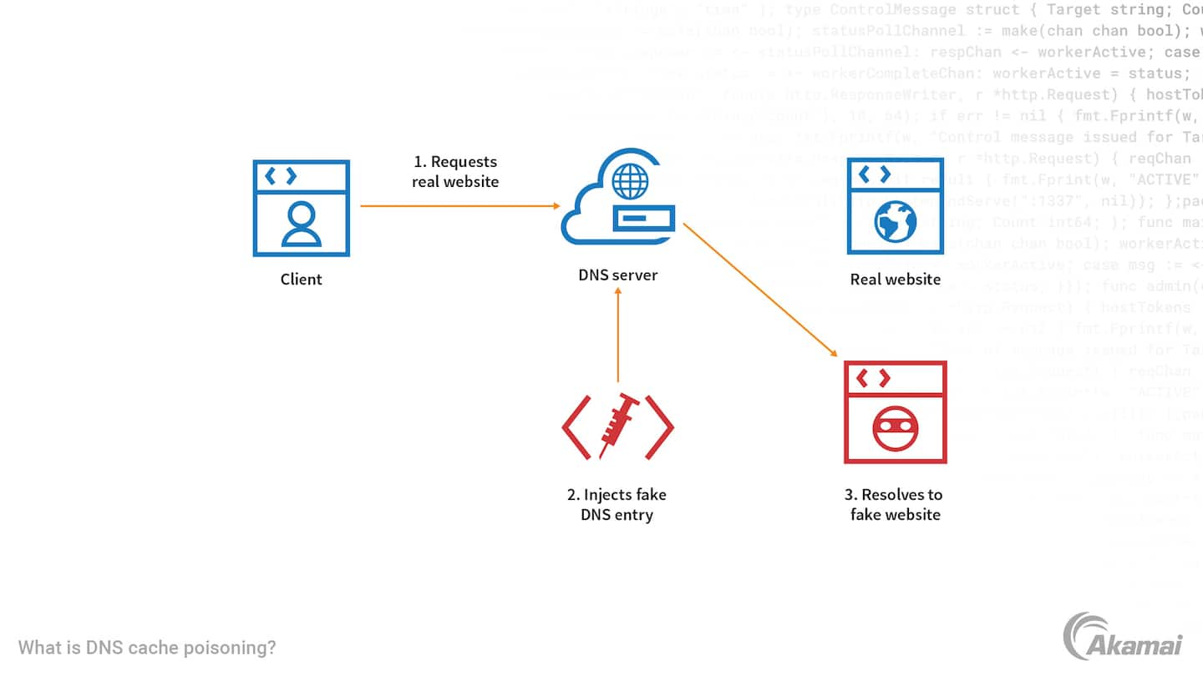

Slide 21
URL obfuscation
A popular technique used by phishers is to somehow disguise the URL of the fake site, so as not to alert a victim of any wrongdoing
For instance, a simple misspelling of a URL might not be noticed by a casual user
Likewise, spam emails that are written in HTML are often displayed in formatted fashion by most email clients
Another trick phishers use is to include a hyperlink in the email that appears real but actually links to a phishing site
For instance, consider the HTML source of a spam email message

Slide 22
URL obfuscation
One variation of this URL obfuscation method is known as the Unicode attack, more formally known as a homeograph attack
Unicode characters from international alphabets may be used in URLs in order to support sites with domain names in multiple languages
so it is possible for phishers to register domain names that are very similar to existing legitimate sites by using these international characters
Even more dangerous, however, is the fact that there are many characters that have different Unicode values but are rendered identically by the browser
A famous example involved a phishing site that registered the domain www.paypal.com using the Cyrillic letter p, which has Unicode value #0440, instead of the ASCII letter p, which has Unicode value #0070
With a valid certificate, the attacker can utilise the semantic attack on websites

Slide 23
Click-jacking
Similar to the idea of URL obfuscation that is used in phishing attacks, click-jacking is a form of web site exploitation where a user’s mouse click on a page is used in a way that was not intended by the user
This piece of HTML code is a simple example that creates a link which appears to be point to www.trustedsite.com.
Moreover, this code may even provide a false sense of security to the user, since many browsers show the target URL of a link in the status bar when the user hovers the mouse pointer on the hyperlink

Slide 24
Click-jacking
Click-jacking extends beyond the action of actually clicking on a page, since it is possible for malicious sites to use other JavaScript event handlers such as onMouseOver
which triggers an action whenever a user simply moves their mouse over that element
Another common scenario where click-jacking might be used is advertisement fraud
Most online advertisers pay the sites that host their advertisements based on the number of click-throughs
how many times the site actually convinced users to click on the advertisements
Click-jacking can be used to force users to unwillingly click on advertisements, raising the fraudulent site’s revenue, which is an attack known as click fraud

Slide 25
Sandboxing
A sandbox refers to the restricted privileges of an application or script that is running inside another application
For example, a sandbox may allow access only to certain files and devices

Slide 26
Sandboxing
Developers are often striving to create new ways of isolating code execution to reduce the impact of malicious behaviour
For example, Google’s Chrome browser runs each new tab as a new process, effectively sandboxing each tab at the operating system level
This tactic mitigates the risk of vulnerabilities allowing browser tabs to access the contents of other tabs by creating a sandbox beneath the application layer

Slide 27
Adobe Flash
Online media content can be another vector for attack
Increasingly, audio and video are embedded into web sites
If an embedded media player used by a web browser to play this content has application-level flaws, malicious media files may be created to escape the sandbox of the victim’s browser and execute code on the victim’s machine
This has been a recurring problem for streaming media technologies
One particularly popular media format is Adobe Flash (formerly known as Macromedia Flash, then Shockwave Flash)
This technology is nearly ubiquitous, and is frequently used to create advertisements or other interactive web content
Like all media content requiring a separate player, however, Flash presents potentials for security vulnerabilities in exploiting application flaws in the Flash media player
Thus, one should always be using the latest version of this player, which will include patches to previously discovered vulnerabilities

Slide 28
Mobile code
What is mobile code?
Executable program
Sent via a computer network
Executed at the destination
Examples
JavaScript
ActiveX
Java Plugins
Integrated Java Virtual Machines

Slide 29
ActiveX vs Java
Windows-only technology runs in Internet Explorer
Binary code executed on behalf of browser
Can access user files outside the sandbox
Support for signed code
An installed control can be run by any site (up to IE7)
IE configuration options – Allow, deny, prompt – Administrator approval
Via Java Applet
Platform-independent via browser plugin
Java code running within browser
Sandboxed execution
Support for signed code
Applet runs only on site where it is embedded
Applets deemed trusted by user can escape sandbox

Slide 30
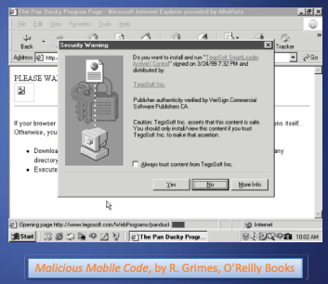
ActiveX
This signed ActiveX control ask the user for permission to run
If approved, the control will run with the same privileges as the user
The “Always trust content from …” checkbox automatically accepts controls by the same publisher
Probably a bad idea

Slide 31
ActiveX
Trusted publishers
List stored in the Windows registry
Malicious ActiveX controls can modify the registry table to make their publisher trusted
All future controls by that publisher run without prompting user
Unsigned controls
The prompt states that the control is unsigned and gives an accept/reject option
Even if you reject the control, it has already been downloaded to a temporary folder where it remains
It is not executed if rejected, but not removed either

Slide 32
Privacy attacks
In addition to privacy-invasive software, like adware and spyware, cookies create a number of specific privacy concerns
For instance, since web servers set cookies through HTTP responses, if a web site has an embedded image hosted on another site, the site hosting the image can set a cookie on the user’s machine
Cookies that are set this way are known as third-party cookies
Most commonly, these cookies are used by advertisers to track users across multiple web sites and gather usage statistics
Some consider this monitoring of a user’s habits to be an invasion of privacy, since it is done without the user’s knowledge or consent
Blocking third-party cookies does not automatically defend against tracking across different websites
Indeed, an advertising network may have image servers hosting multiple domain names from participating websites

Slide 33
Privacy attacks
Modern browsers include a number of features designed to protect user privacy
Browsers now include the ability to specify policies regulating how long cookies are stored and whether or not third-party cookies are allowed
In addition, private data such as the user’s history and temporarily cached files can be set to be deleted automatically
Finally, to protect a user’s anonymity on the Web, proxy servers can be used
Most modern web browsers have a “private browsing” mode
preventing the storage of any cookies and the recording of any browsing history while in this mode

Slide 34
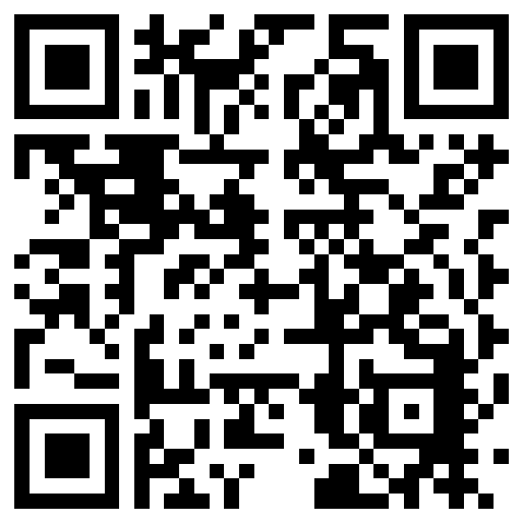
The lecture slides can be found in the following location!

